Slide 1


NAAN MUDHALVAN
JEPPIAAR ENGINEERING COLLEGE
B Tech Biotechnology Department

Slide 2
TEAM MEMBERS
CHRISTINA SHALOM R
GOKUL
RISHI VARMA
TEAM LEADER
4. ROHINI L
TEAM MENTOR
GOPI ANAND

Slide 3
OUR PROJECT TITLE
How to Create a Brand Name, Brand Mail and Brand Logo by using Canva.
Category: DIGITAL MARKETING
Skills Required: DIGITAL MARKETING
Our Product for this project: SUNSCREEN LOTION

Slide 4
OUR TARGET AUDIENCE
Our Product Description:
One of the best ways to understand the target market for sunscreen is to understand the reasons why people need and use the product. Not everyone needs sunscreen. And most people who need it do not need it all the time.
Such a needs-based analysis gives us the following segments of the target market for sunscreen:
People who work outdoors in the sun
People with skin that is over-sensitive to the sun
People who want to avoid getting a sunburn
People heading on vacation
People going to the beach
People who live in sunny climates
Children (they are in a category of their own)

Slide 5
Our Brand personality
Check the label for products that are lotion-based (instead of spray), water-resistant, and are broad-spectrum (protect from both UVA and UVB rays).
Look for products that are at least SPF 15 but no higher than SPF 50. Sunscreen that is higher than SPF 50 is not proven to be more effective than lower SPF sunscreen, and an i
Look for mineral based sunscreens such as zinc oxide and titanium dioxide. These block UV rays better than chemical sunscreens, and have less adverse health and environmental effects.
Check the ingredient label and try to avoid products that:
contain Oxybenzone or Octinoxate, which are hormone disrupting chemicals and are known to cause damage to coral reefs
contain Vitamin A (also known as retinyl palmitate or retinol) which may speed the development of skin tumors and lesions
contain methylparaben or ethylparaben (also known as parabens) or fragrance. Parabens are a class of chemicals that may have estrogenic activity (can affect your hormones) and may also react with UVB rays, resulting in DNA damage

Slide 6
OUR BRAND NAME
“protecto”
Our product is based on the sunscreen protection lotion from UV rays like UVA & UVB rays.
“PROTECTO”- It means a protective layer from the lotion for the sun rays.

Slide 7
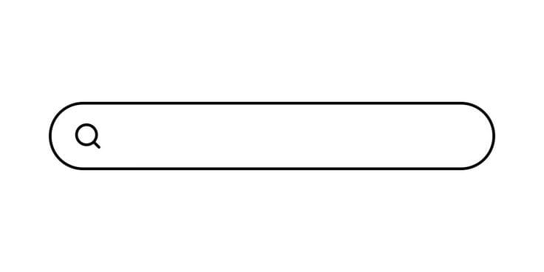
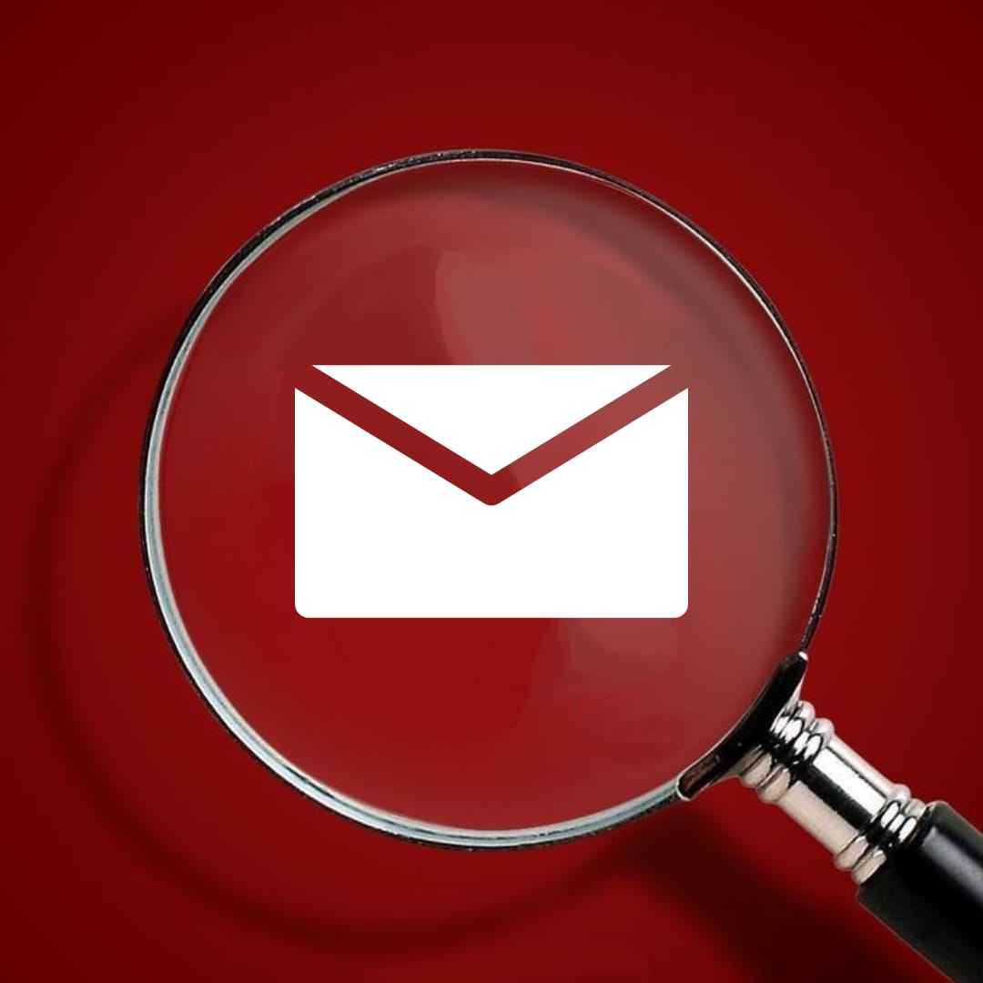
OUR MAIL ID:
protectosunscreens@gmail.com
Our email is based on the name of our brand which is Protecto

Slide 8
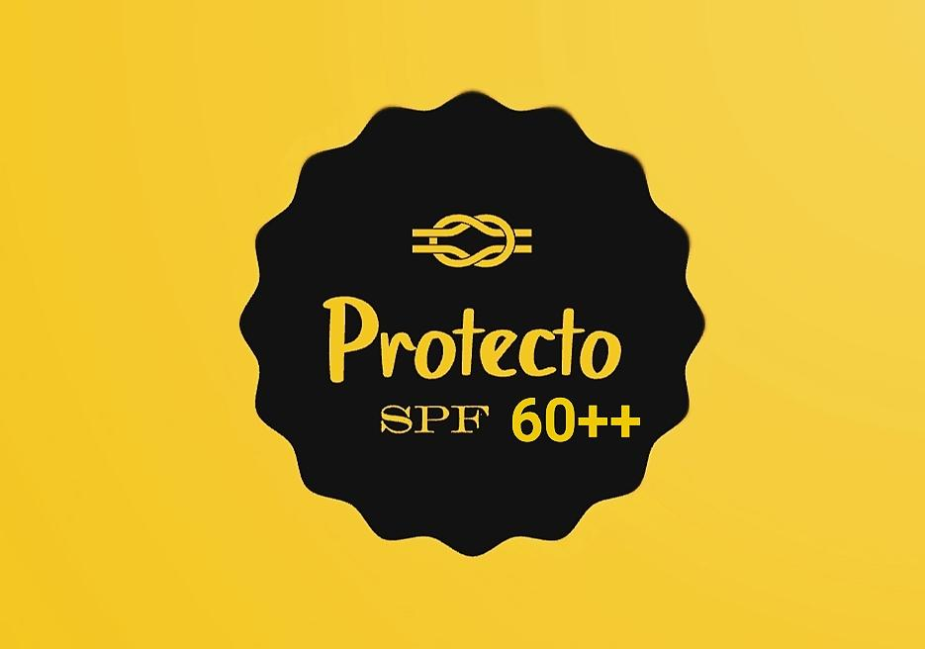
OUR LOGO
LOGO DESCRIPTION:
The YELLOW colour on the background depicts the rays of the Sunlight which is Ultraviolet Rays.
The BLACK on the logo which is in the circle like shape depicts the protection layer of our product (SUNSCREEN LOTION).
The KNOT- depicts how strong our product is on the skin.
SPF- Sun protection factor, our product has 60++ protection.
SPF 60 sunscreen absorbs 98.3%,
++- Protects from UVA & UVB layers

Slide 9

THANK YOU
protectosunscreens@gmail.com

